Slide 1
Spotify Picture-in-Picture Application
Benjamin Hicks
Summer Gasaway
Keshawn Thomas
Marco Bahns

Slide 2
Concept
Improve Spotify’s user experience and enhance productivity with a seamless multitasking feature that allows users to enjoy their favorite music while engaging in other activities on their device.
Integrate miniature and resizable overlay with the Spotify application, enabling users to play, pause, skip, and backtrack their music without disrupting their primary task.

Slide 3
Key Features
Resizable and movable
Users can adjust the size and position of the overlay to accommodate their preferences and screen real estate.
Multitasking support
Users can change tracks and increase or decrease volume on Spotify while simultaneously using other applications.
Customization options
Users can personalize their experience by modifying display preferences such as the overlay’s transparency.

Slide 4
Album artwork
SONG TITLE
ARTIST NAME

Slide 5
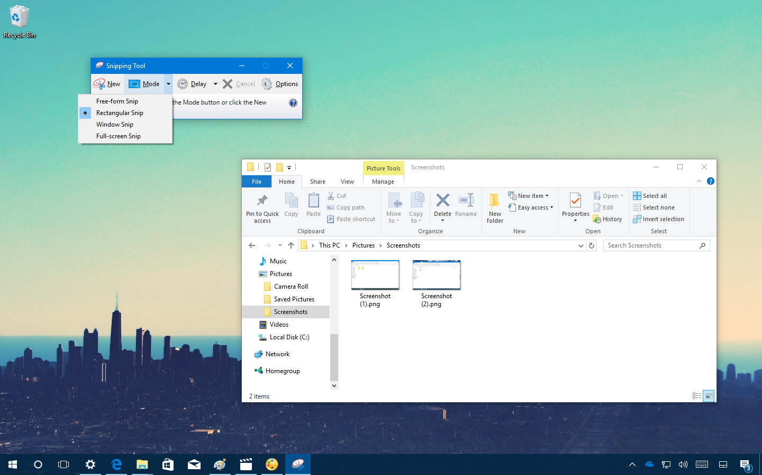
Album Artwork
SONG TITLE
ARTIST NAME

